Slide 1
Course : COMP8043041 – Machine Learning
Period : June 2023
Introduction to Machine Learning
Session 01
KDS – Amalia Zahra, S.Kom., Ph.D.

Slide 2
Learning Outcomes
After the completion of this session, students are expected to achieve the following learning outcomes:
LO1: Understand the fundamental concept of Machine Learning and know its various techniques/algorithms.

Slide 3
Topics
Introduction
What is Machine Learning?
Supervised Learning
Unsupervised Learning
Real-Life Applications of Machine Learning
Machine Learning Technologies

Slide 4
Machine Learning is in Your Everyday Life
Search Engine, such as Google, Bing.
Facebook
Recognizing your friends’ photos
Spam and Non-Spam Email Filtering

Slide 5
Other Examples
Database mining: large datasets from growth of automation/web
Web click data, clickstream data, etc
Medical record
Gene/DNA sequences
Applications that can’t be programmed by hand.
Handwriting recognition
Natural Language Processing (NLP)
Computer Vision
Recommendation system

Slide 6
What is Machine Learning?
Arthur Samuel (1959). Machine Learning is the field of study that gives computers the ability to learn without being explicitly programmed.
Tom Mitchell (1998). A well-posed learning problem: A computer program is said to learn from experience E with respect to some task T and some performance measure P, if its performance on T, as measured by P, improves with experience E.

Slide 7
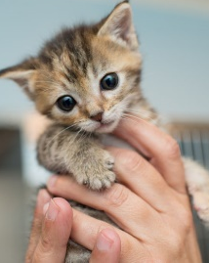
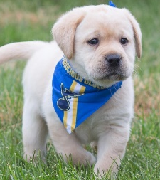
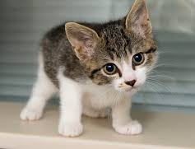
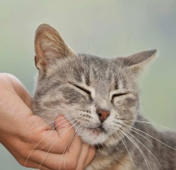

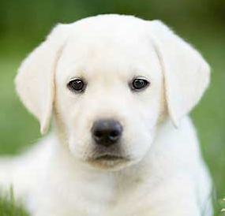
Traditional Approach
Feature Extraction
Set of Rules
Output
If f1=“yes” and f2<2 then “bird”
Else if f2=“no” and f3=5 and f4<1 then “cat”
Else if f1=“Yes” and f2<2 and f4=“yes” then “dog”
Else if f2=“no” and f5>10 and f1=“no” then fish
.....
Dog
Cat
Bird
Fish

Slide 8
Machine Learning Approach
Feature Extraction
Machine Learning Model
Output
Dog
Cat
Bird
Fish

Slide 9
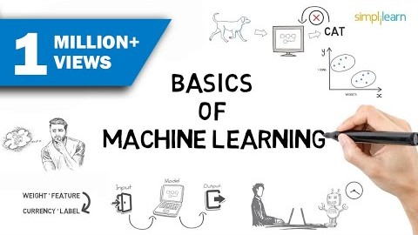
What is Machine Learning?
Notes:
Source: https://www.youtube.com/watch?v=ukzFI9rgwfU

Slide 10
Quiz
Suppose Facebook program watches you tagging several photos with who are in the photos. Based on that, it learns face recognition to be able to identify whose face in your photos. What is the task T in this scenario?
Identifying whose faces appearing in the photos
Watching you tag the people in photos
The number of faces in the photos that are correctly identified
None of the above – this is not a machine learning problem.

Slide 11
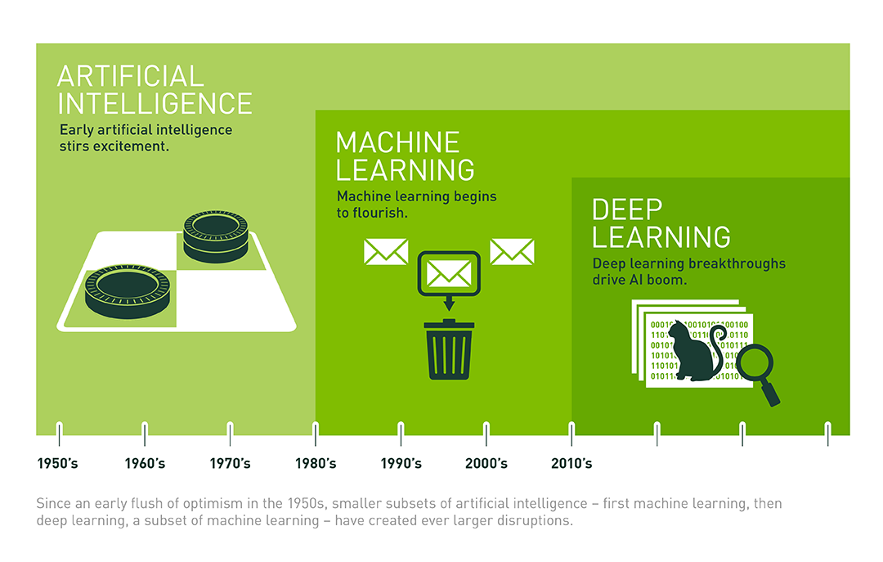
AI vs ML vs DL

Slide 12
AI vs ML vs DL
Artificial Intelegence
Deep Learning
Machine Learning
Techniques that make computers have knowledge like humans.
Techniques to teach computers without being explicitly programmed.
Learning to understand features from data using artificial neural networks.

Slide 13
Some of Machine Learning Techniques
Regression
Predicting a continuous number
Classification
Predicting a class/label/category
Clustering
Grouping data into several clusters
Association Analysis
Analyzing relationship or association among items.
Recommender System
etc

Slide 14
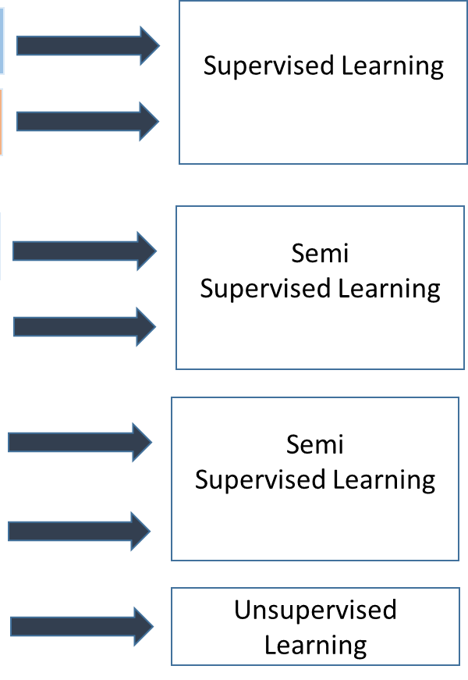
Types of Machine Learning
Human
Machine
Human
Machine
Human
Machine
Machine

Slide 15
Supervised Learning

Slide 16
Supervised Learning
Humans teach the computer how to do something
Available
Available
Machine Learning Algorithms
Input Data
Output Data

Slide 17
Regression Analysis
Predict a value of a given continuous valued variable based on the values of other variables, assuming a linear or nonlinear model of dependency.
Greatly studied in statistics
Examples:
Predicting sales amounts of new product based on advertising expenditure.
Predicting wind velocities as a function of temperature, humidity, air pressure, etc.

Slide 18
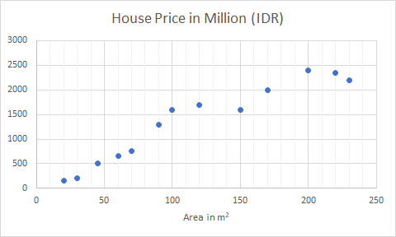
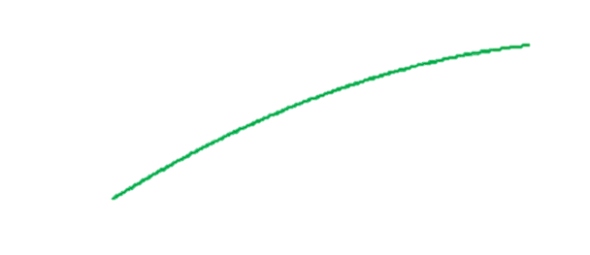
Regression Example 1: House Price Prediction
x
“correct answer” is given
regression: predict continuous value

Slide 19
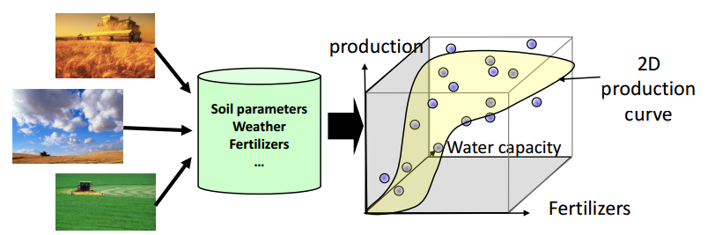
Regression Example 2: Precision Farming
Create a production curve depending on parameters like soil characteristics, weather, and used fertilizers.

Slide 20
Classification
Given a collection of records (as training set), each record contains a set of attributes, one of the attributes is the class.
Find a model for class attribute as a function of the values of other attributes.
Goal: previously unseen records should be assigned a class as accurately as possible.
A test set is used to determine the accuracy of the model. Usually, the given data set is divided into training and test sets, with training set used to build the model and test set used to validate it.

Slide 21
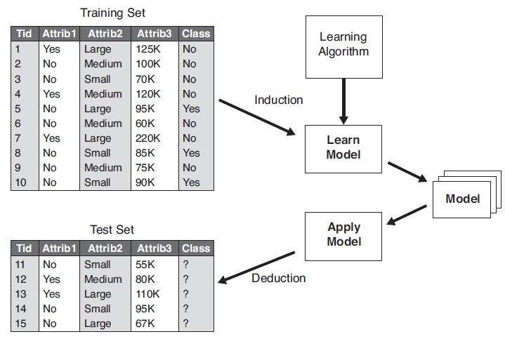
Classification - Illustration

Slide 22
Classification Example 1: Tumor Prediction: Benign/Malignant
class
tumor size (diameter in mm) | age (year) | benign/malignant
15 | 45 | benign
55 | 60 | malignant
17 | 53 | benign
27 | 36 | benign
60 | 25 | benign
58 | 51 | malignant
72 | 46 | malignant
category
“correct answer” is given
classification: predict discrete value (category)

Slide 23
Classification Example 1: Tumor Prediction: Benign/Malignant
malignant
benign
malignant
benign

Slide 24
Classification Example 2: Fraud Detection
Goal: Predict fraudulent cases in credit card transactions.
Approach:
Use credit card transactions and the information on its account-holder as attributes.
When does a customer buy, what does he buy, how often he pays on time, etc.
Label past transactions as fraud or fair transactions. This forms the class attribute.
Learn a model for the class of the transactions.
Use this model to detect fraud by observing credit card transactions on an account.

Slide 25
Classification Example 3: Customer Attrition/Churn
Goal: To predict whether a customer is likely to be lost to a competitor.
Approach:
Use detailed record of transactions with each of the past and present customers, to find attributes.
How often the customer calls, where he calls, what time-of-the day he calls most, his financial status, marital status, etc.
Label the customers as loyal or disloyal.
Find a model for loyalty.

Slide 26
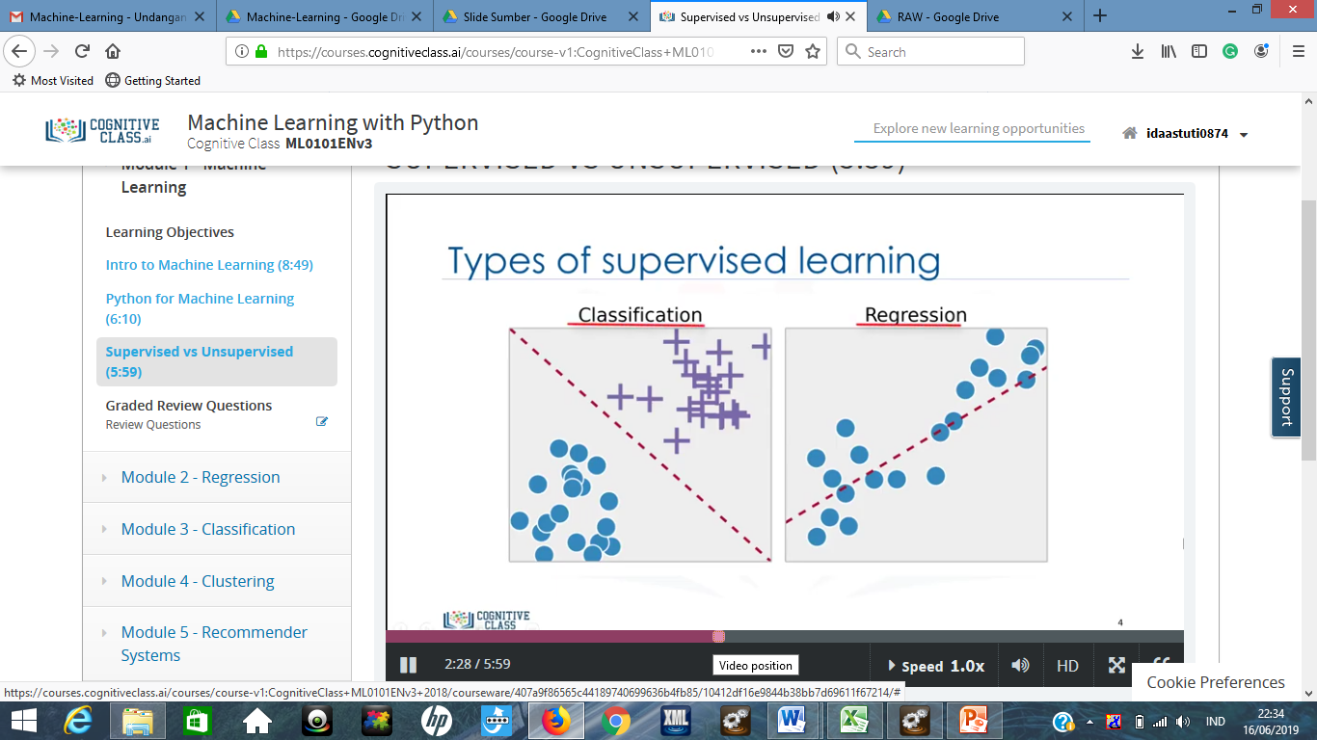
Regression vs Classification

Slide 27
Quiz
You’re running a company, and you want to develop learning algorithms to address each of the following two problems:
Problem 1: Your company is going to launch a new product soon. You want to predict how many of them will be sold over the next 3 months.
Problem 2: You observe social media activities related to the launch of the new product and try to identify whether people have positive/ negative opinions about it.
Should you threat these as classification or regression problems?
Treat both as classification problems.
Treat problem 1 as a classification problem; problem 2 as a regression problem.
Treat problem 1 as a regression problem; problem 2 as a classification problem.
Treat both as regression problems.
Notes:
Jawaban: c

Slide 28
Unsupervised Learning

Slide 29
Unsupervised Learning
Let the computer learn by itself!
Available
Unavailable
Machine Learning Algorithms
Input Data
Output Data

Slide 30
Clustering
Given a set of data points, each having a set of attributes, and a similarity measure, find clusters such that
Data points in one cluster are more similar to one another.
Data points in separate clusters are less similar to one another.
Similarity Measures:
Euclidean Distance if attributes are continuous.
Other Problem-specific Measures.

Slide 31
Tumor Prediction Using Unsupervised Learning
clustering
“correct answer” is not given
let the computer divide the data
(unsupervised learning)

Slide 32
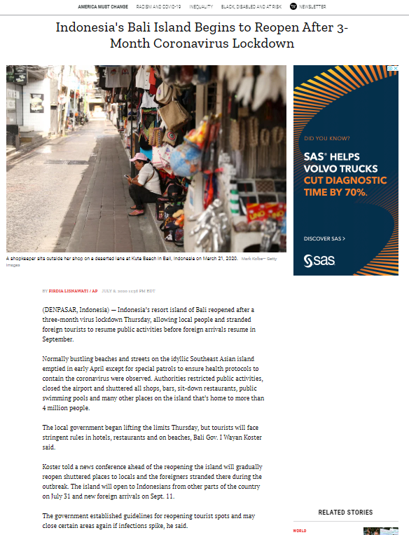

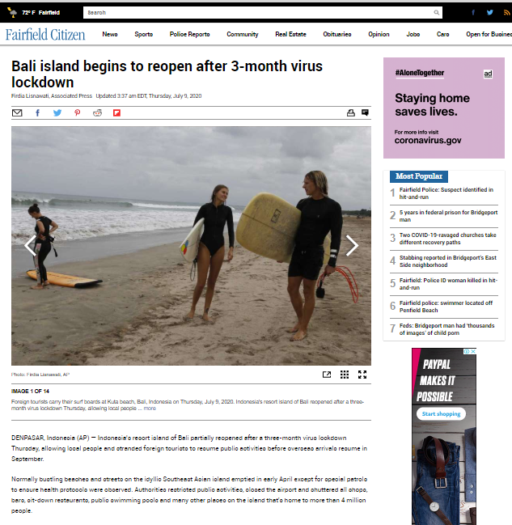
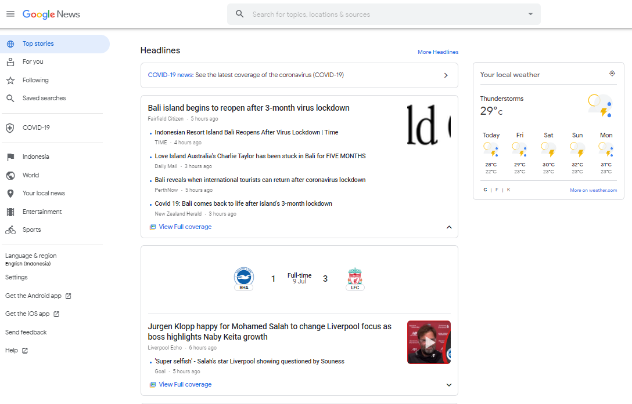
Example-1: Google News

Slide 33
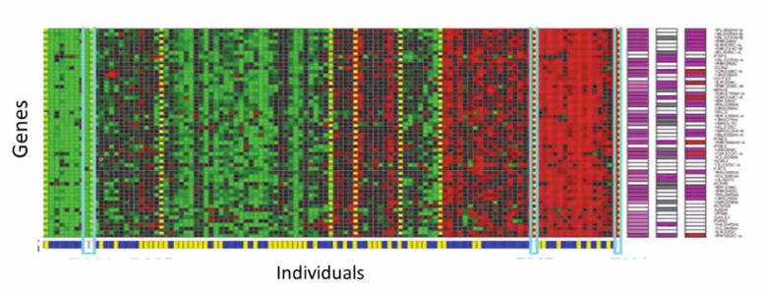
Example-2: Genes/Genomes
DNA microarray data
Goal: group individuals into different categories or different types of people
[Source: Su-In Lee, Dana Pe’er, Aimee Dudley, George Church, Daphne Koller]

Slide 34
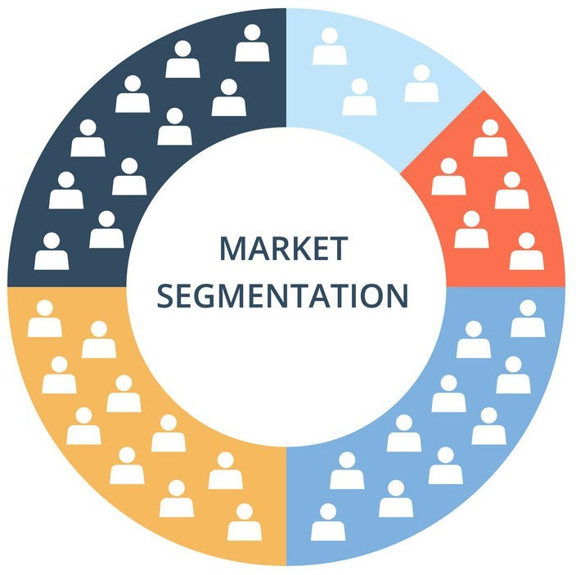
Example-3: Market Segmentation
data: customer information
automatically discover market segments
automatically group customers into different market segments
Goal: targeted marketing
[source: https://businessyield.com/marketing/market-segmentation/]

Slide 35
Association Analysis
Given a set of records each of which contain some number of items from a given collection;
Produce dependency rules which will predict occurrence of an item based on occurrences of other items.
TID | Items
1 | Bread, Coke, Milk
2 | Noodle, Bread
3 | Noodle, Coke, Diaper, Milk
4 | Noodle, Bread, Diaper, Milk
5 | Coke, Diaper, Milk
Rules Discovered:
{Milk} → {Coke}
{Diaper, Milk} → {Noodle}

Slide 36
Quiz
Of the following examples, which would you address using unsupervised learning algorithm? (Check all that apply)
Given a set of news articles found on the web, group them into set of articles that talk about the same story.
Given a dataset of weather information in Jakarta for the last 3 years as sunny, rainy, and cloudy, learn to predict the weather tomorrow.
Given a dataset of customer data, discover market segments automatically and group customers into different segments.
Given a dataset of patients diagnosed as either having cervical cancer or not, learn to classify new patients as having cervical cancer or not.
Notes:
Answer: a, c

Slide 37
Supervised vs Unsupervised Learning
Supervised learning
Unsupervised learning
predictive
Has a specific labels to classify data item
Used for regression analysis, classification
descriptive
No label required
Maps a data item into several categories (clusters)
Used for association analysis, clustering, feature extraction

Slide 38
Real-Life Applications of Machine Learning

Slide 39

Notes:
Source of image: https://www.vectorstock.com/royalty-free-vector/weather-forecast-vector-11181087

Slide 40
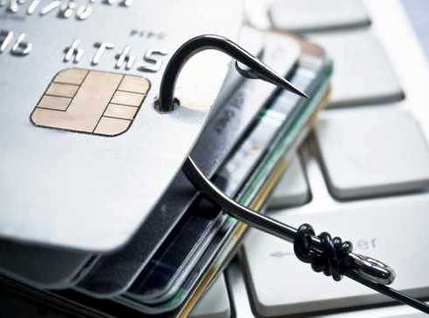
Credit Card Fraud Detection
Notes:
Source of image: https://www.iol.co.za/ios/news/pensioners-targeted-in-rising-credit-card-fraud-21021877

Slide 41
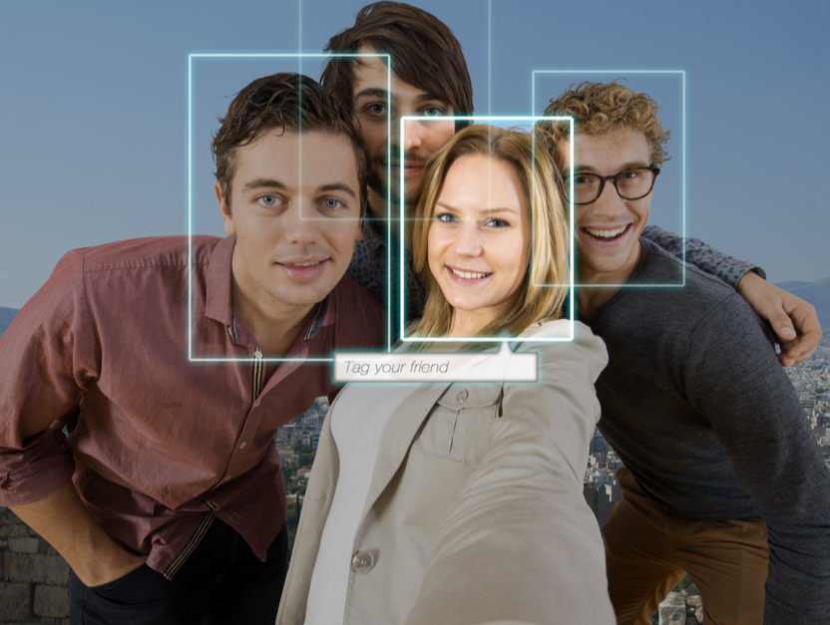
photo tagging on social media
Notes:
Source of image: https://nakedsecurity.sophos.com/2019/09/06/facebook-expands-use-of-face-recognition/

Slide 42
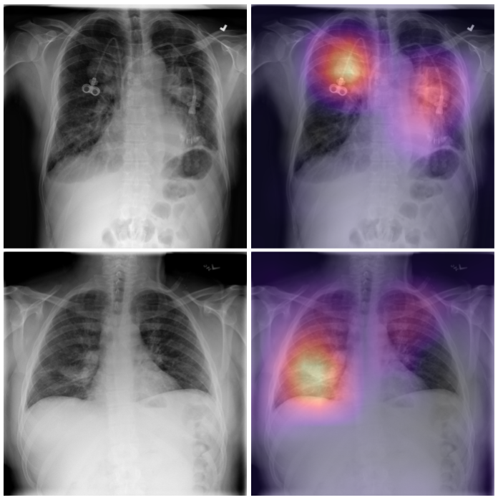
Predicting diseases based on x-ray images

Slide 43
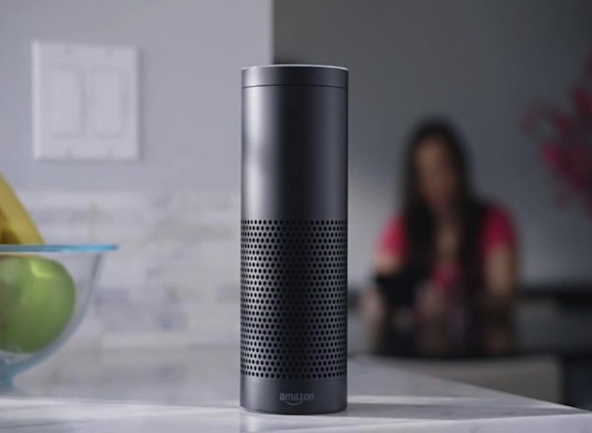
Amazon Alexa
Notes:
Source of image: https://threatpost.com/voice-squatting-turns-alexa-google-home-into-silent-spies/132068/

Slide 44
Machine Learning Technologies

Slide 45

Apache MXNet
A scalable deep learning framework
Open-source
https://mxnet.apache.org

Slide 46

PyTorch
Open-source machine learning library for Python.
Based on the Torch machine learning library.
It includes tensor computation with strong GPU acceleration and deep neural networks.
https://pytorch.org/

Slide 47

TensorFlow
An end-to-end open-source machine learning platform.
It has its own ecosystem of related technologies.
https://www.tensorflow.org/

Slide 48

Keras
It is a high-level API built on top of TensorFlow.
More user-friendly way to access the benefits of TensorFlow without the need to go deep into TensorFlow itself.
https://keras.io/

Slide 49
Class Exercise
Find 3 other examples (besides those mentioned in this material) each for supervised and unsupervised learning! Explain!

Slide 50
References
Bishop, C. M. (2006). Pattern recognition and machine learning. springer.
Mitchell, Tom M. (1997). Machine learning. McGraw Hill.
Flach, P. (2012). Machine learning: the art and science of algorithms that make sense of data. Cambridge University Press.
Harrington, P. (2012). Machine learning in action. Manning Publications Co..

Slide 51
Q&A

Slide 52
Thank You

